Slide 1

STUDY ON AIR POLLUTION LEVELS ACROSS INDIA
AI with IBM WATSONX
PRESENTATION BY
PAVANCHANDRA DEVANG L [1JS22CS106]
P PRAJWAL BHARADWAJ [1JS22CS103] PARATPAR GURUDEV GOUD [1JS22CS105] PRASAD A PARIT [1JS22CS115]

Slide 2
Introduction
This project uses IBM Watsonx AutoAI to automate regression and classification tasks, predicting air quality and classifying sleep quality. It simplifies model building, enhances performance evaluation, and offers insights with minimal manual effort.

Slide 3
Overview – SMOGWATCH using IBM Watsonx
SMOGWATCH uses IBM Watsonx AutoAI to predict air pollution levels across India. It automates AQI forecasting, identifies pollution hotspots, and supports data-driven decisions for public health and urban planning.

Slide 4
Module Sequencing
01
04
Evaluation Module
Data Preprocessing
Module
02
05
Upload & Integration
Deployment
03
AutoAI Model Builder

Slide 5
Interpretation
The Snap Random Forest algorithm outperformed standard Random Forest implementations by integrating enhanced splitting criteria, parallel processing, and internal feature selection mechanisms. Its consistent performance in both regression and classification tasks demonstrates its versatility and robustness. These results highlight the capability of IBM Watsonx AutoAI in automatically selecting and tuning advanced algorithms for optimal outcomes.

Slide 6
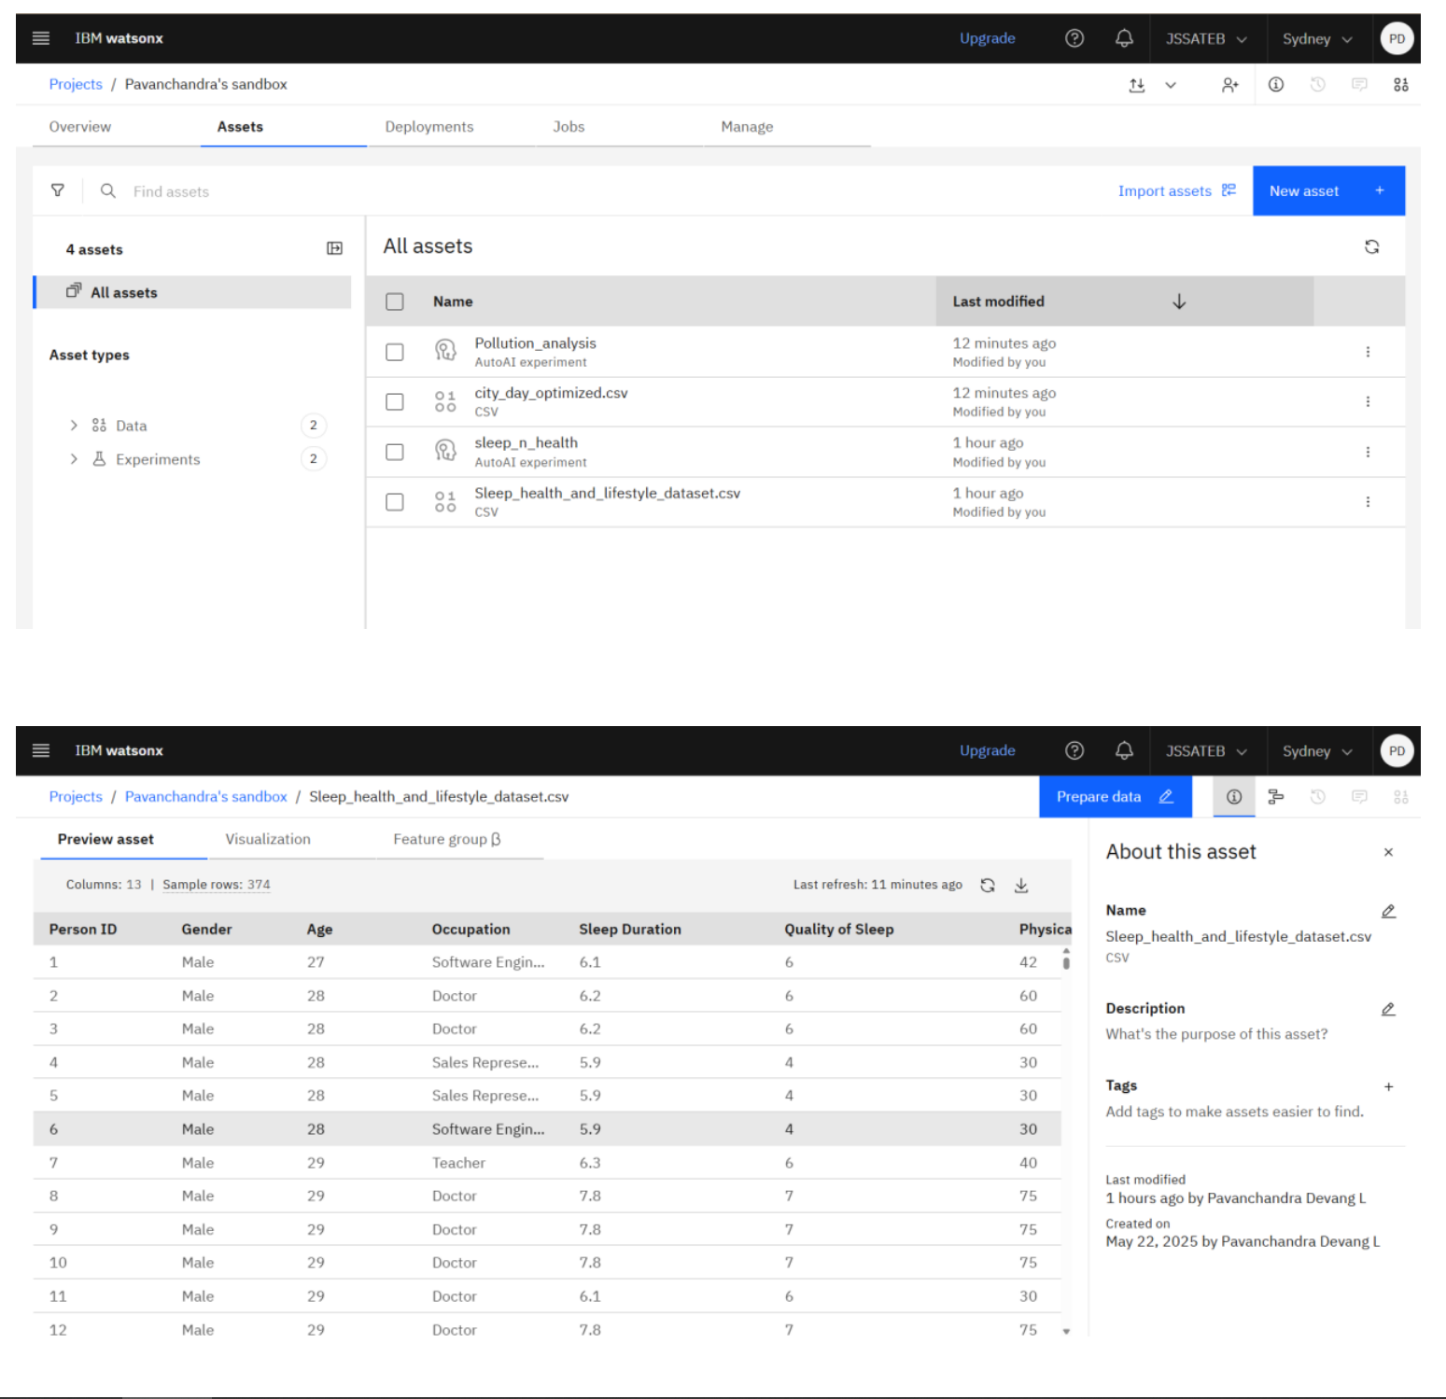
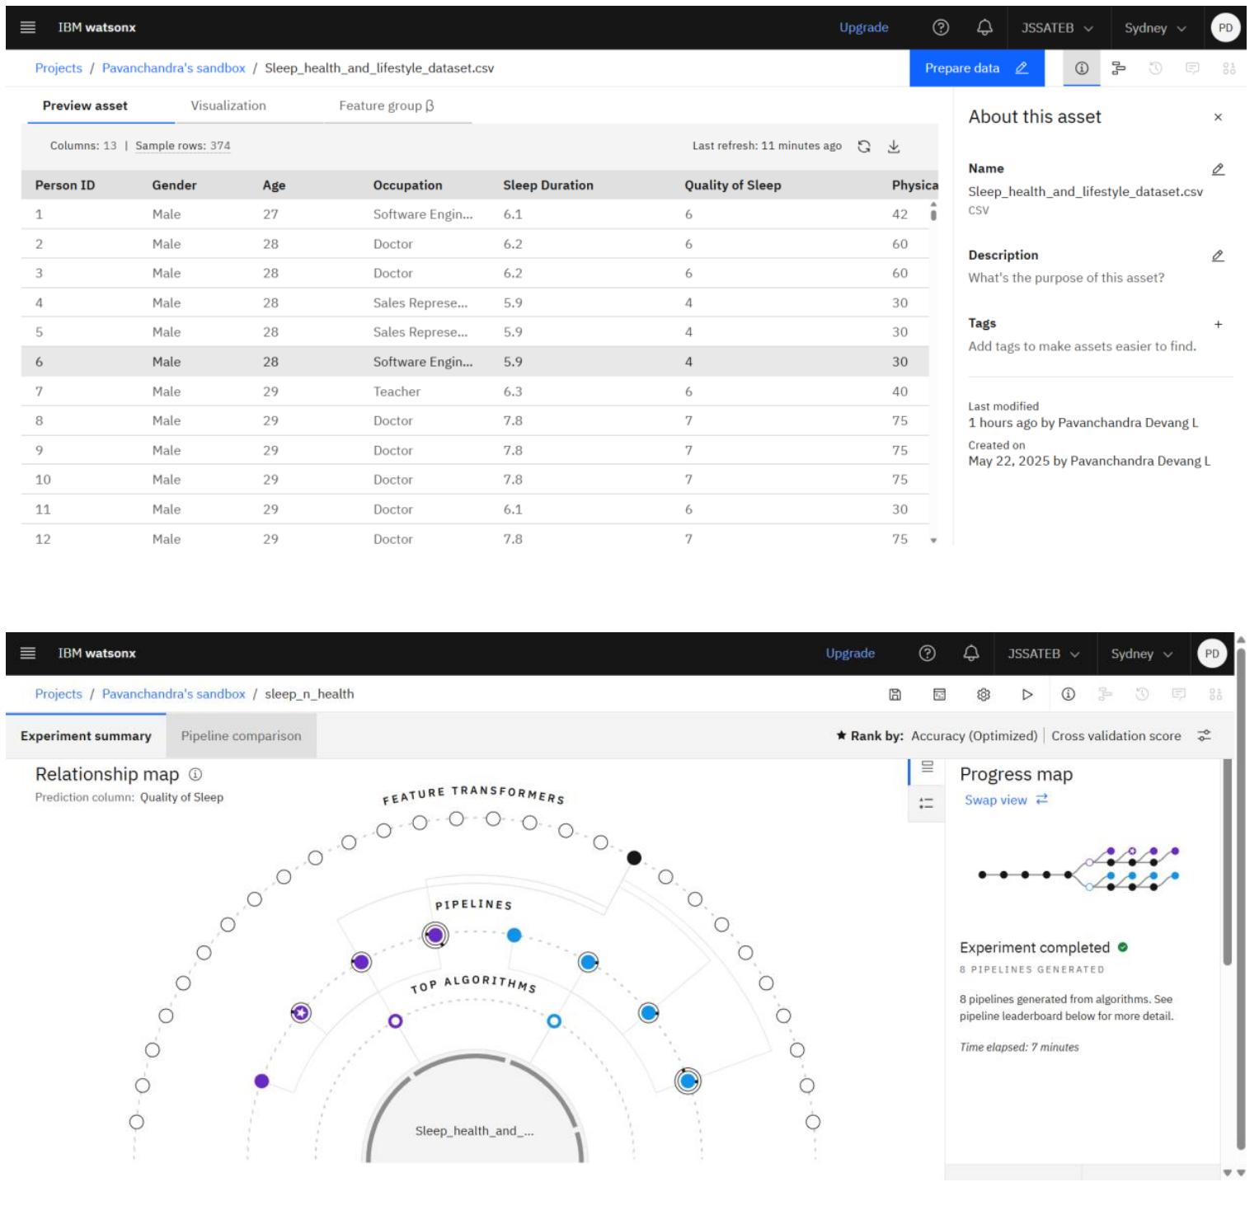

Slide 7
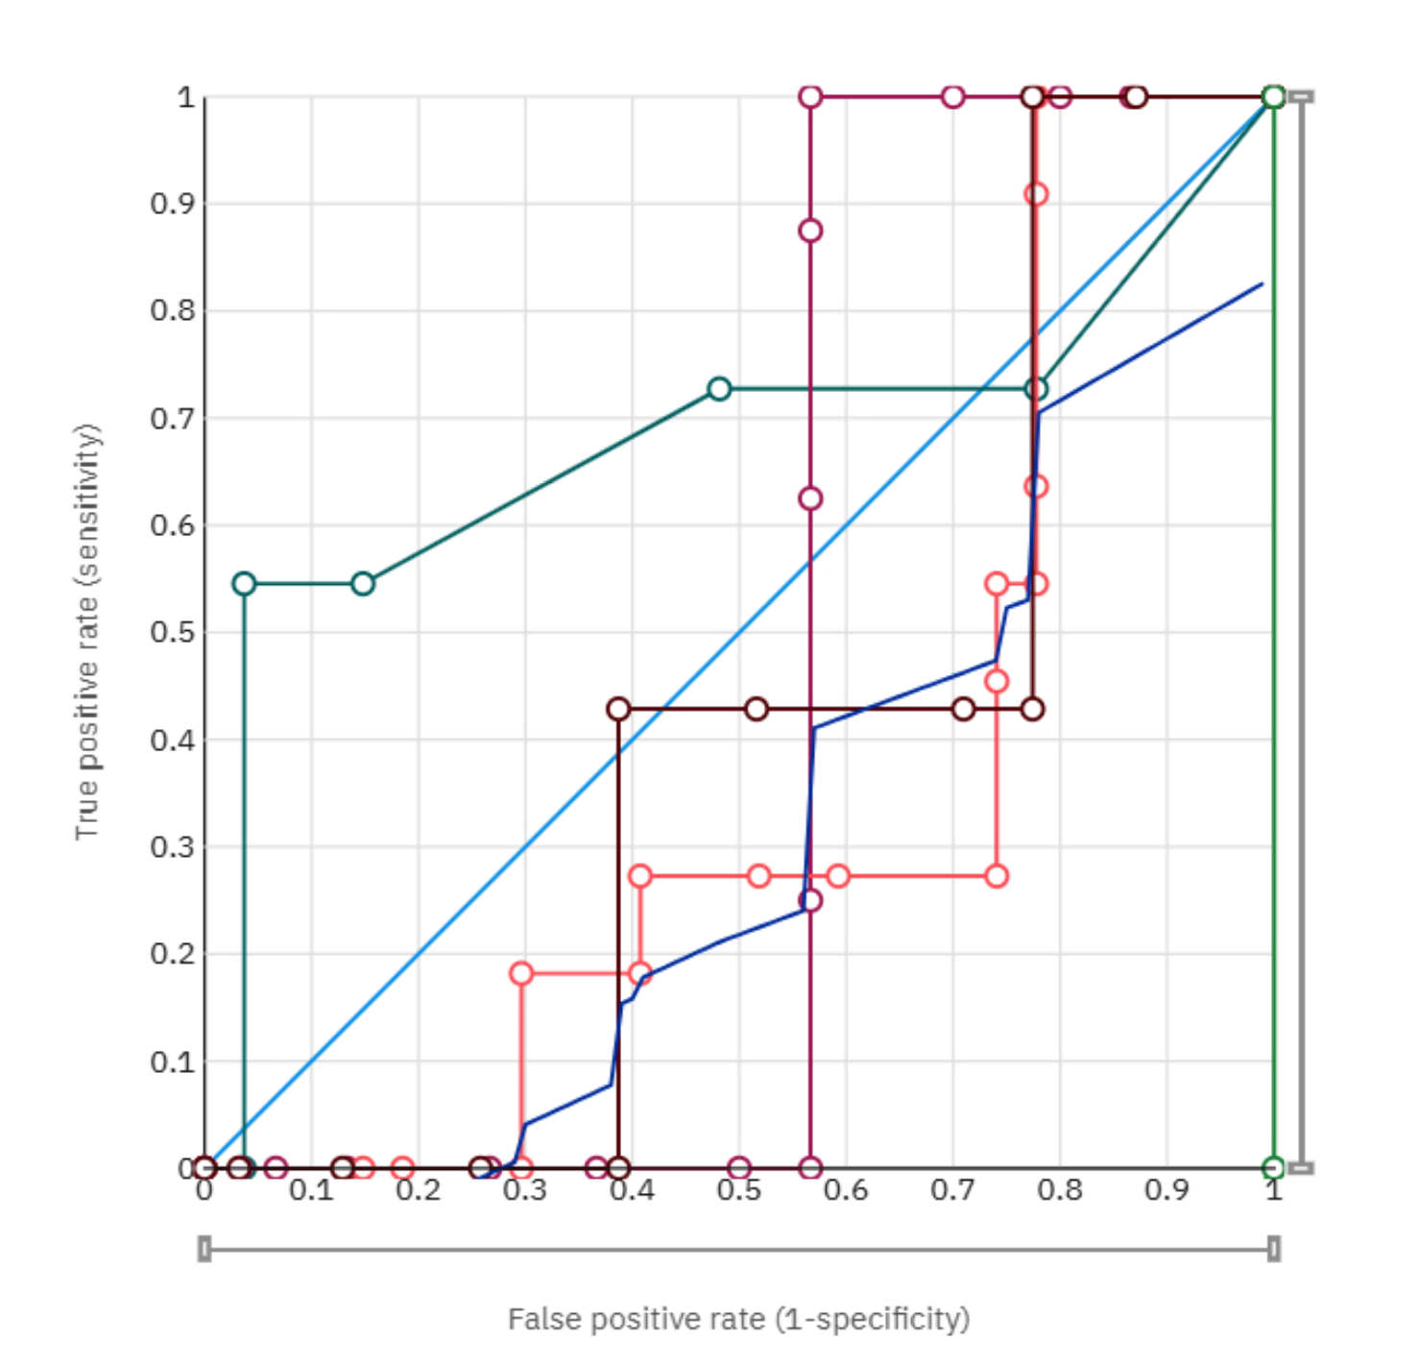
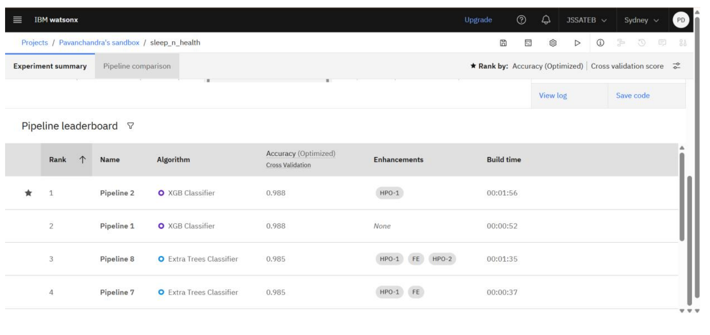

Slide 8
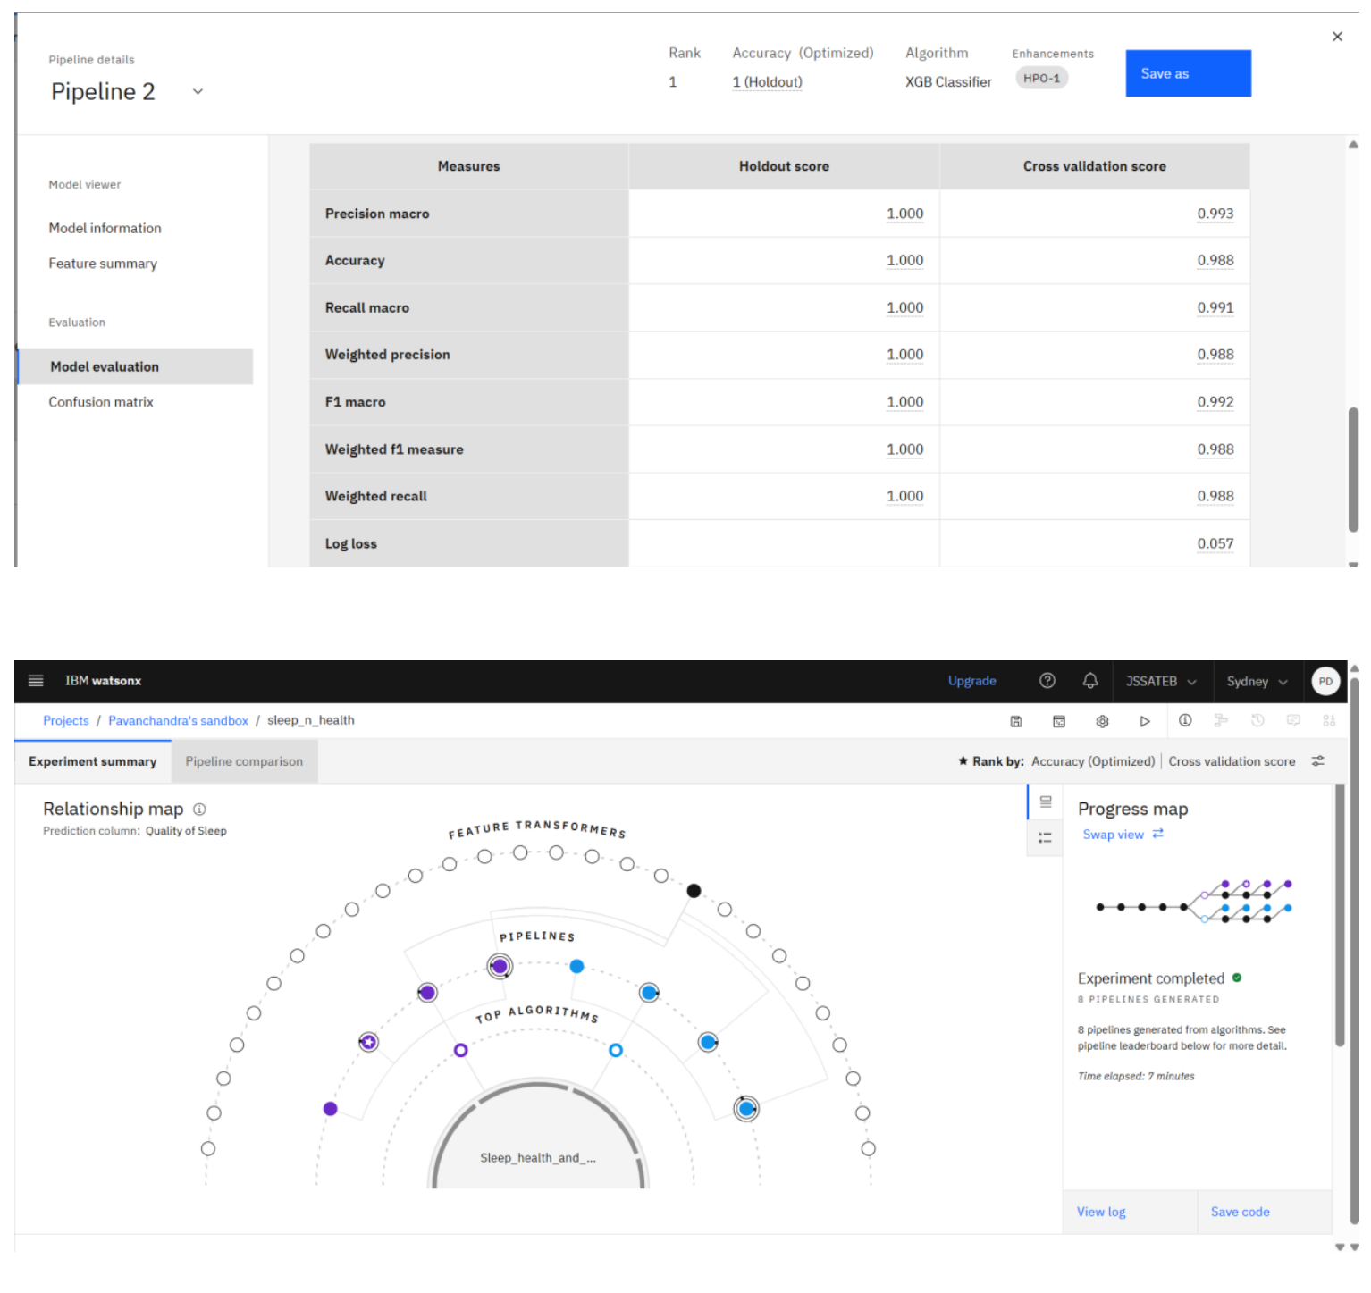
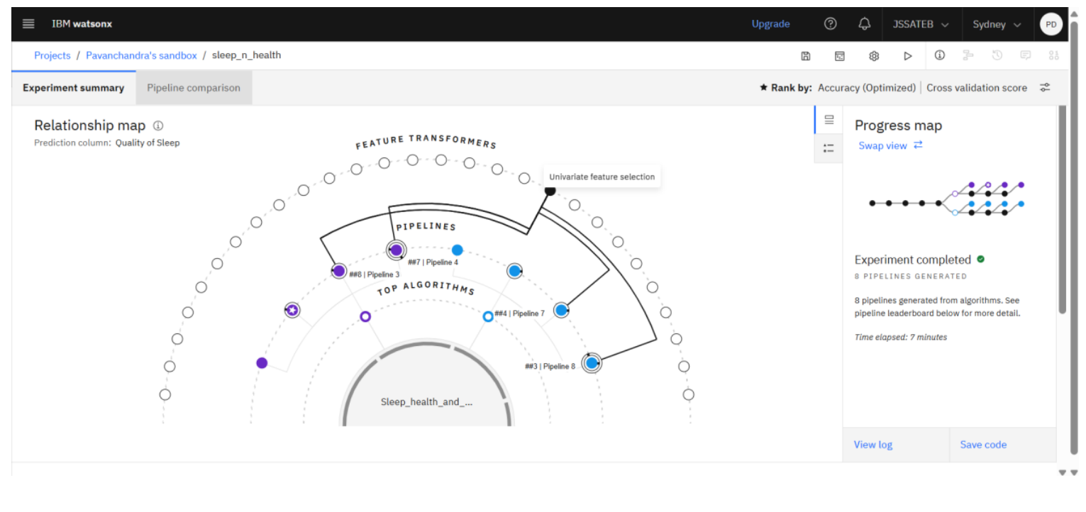
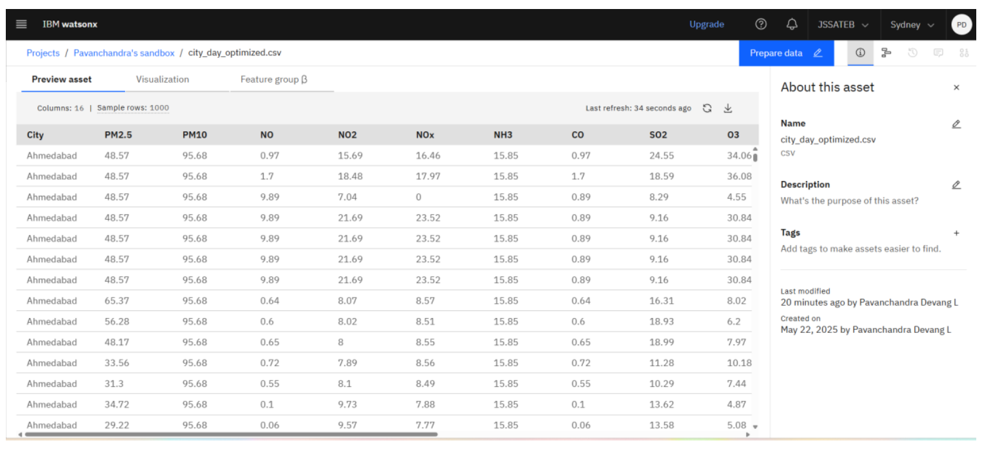

Slide 9
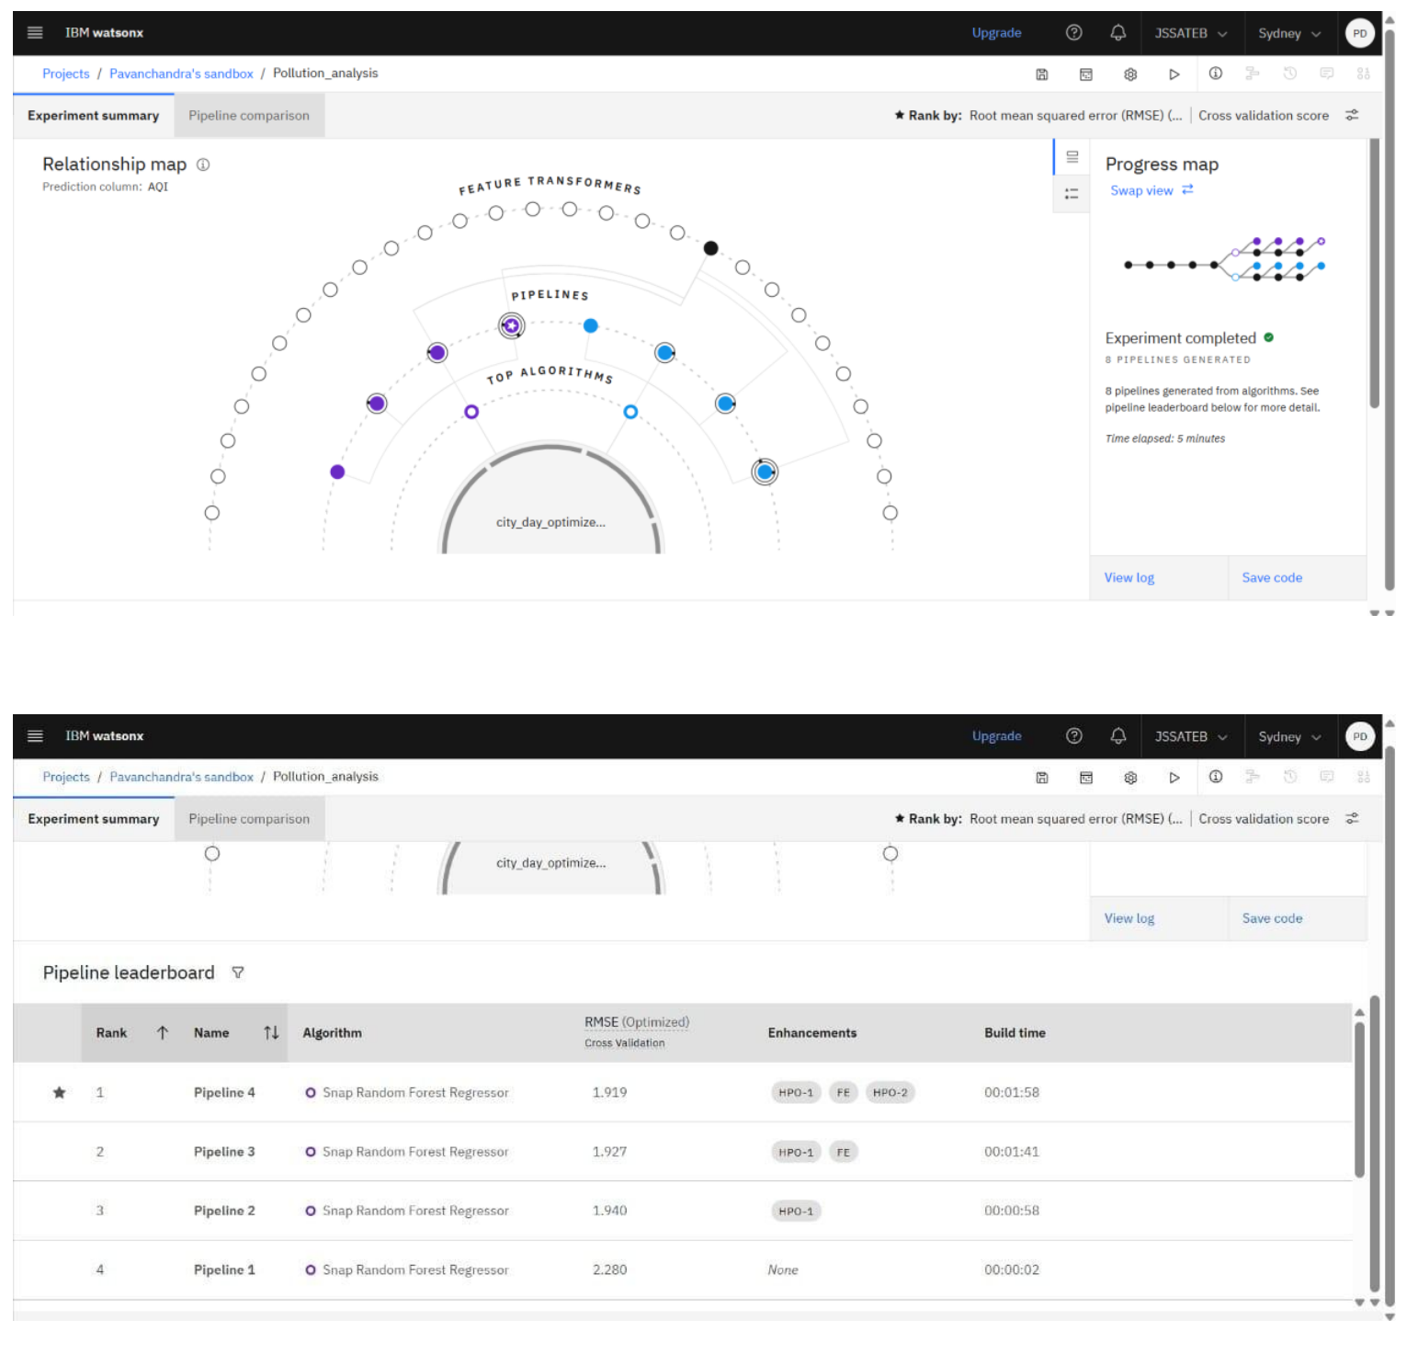
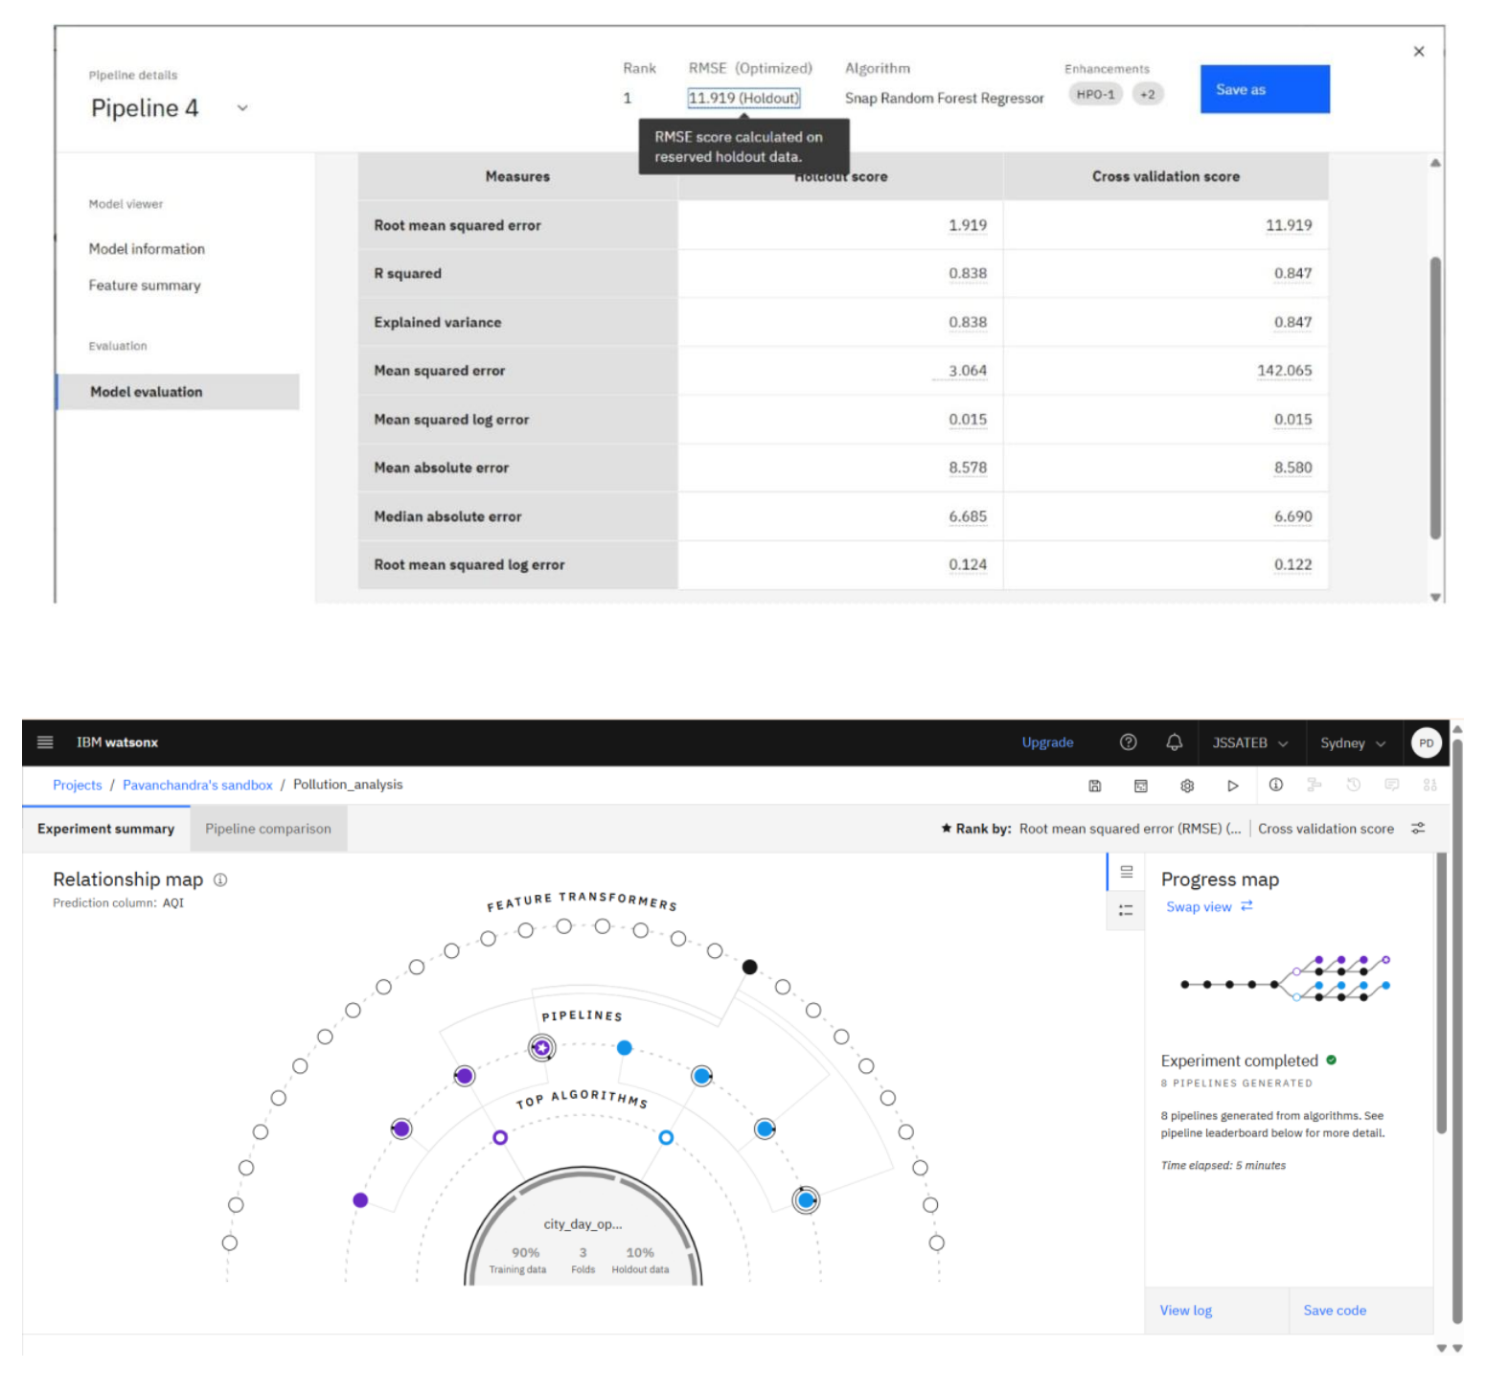

Slide 10
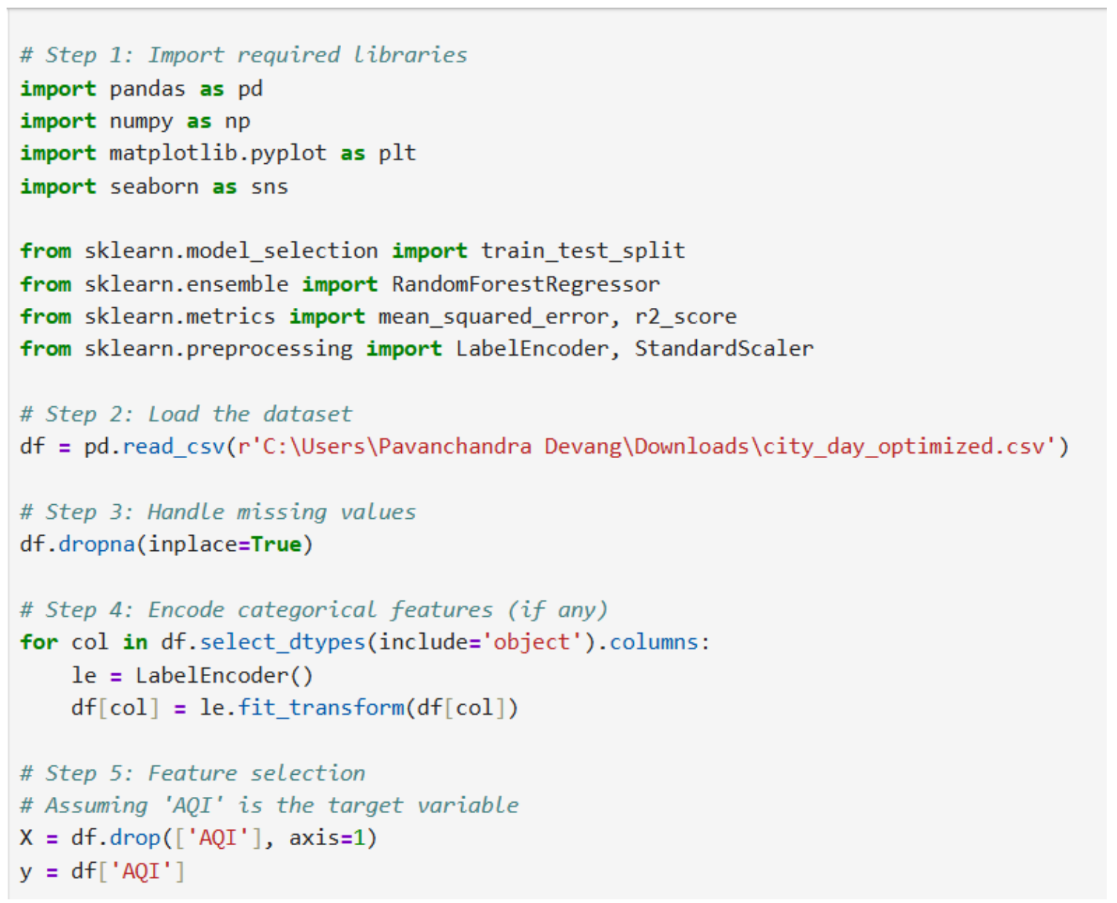
Data Analysis Using Regression Algorithms with Manual Approach
Predict AQI manually using coding frameworks like Python (Scikit-learn, Pandas).

Slide 11
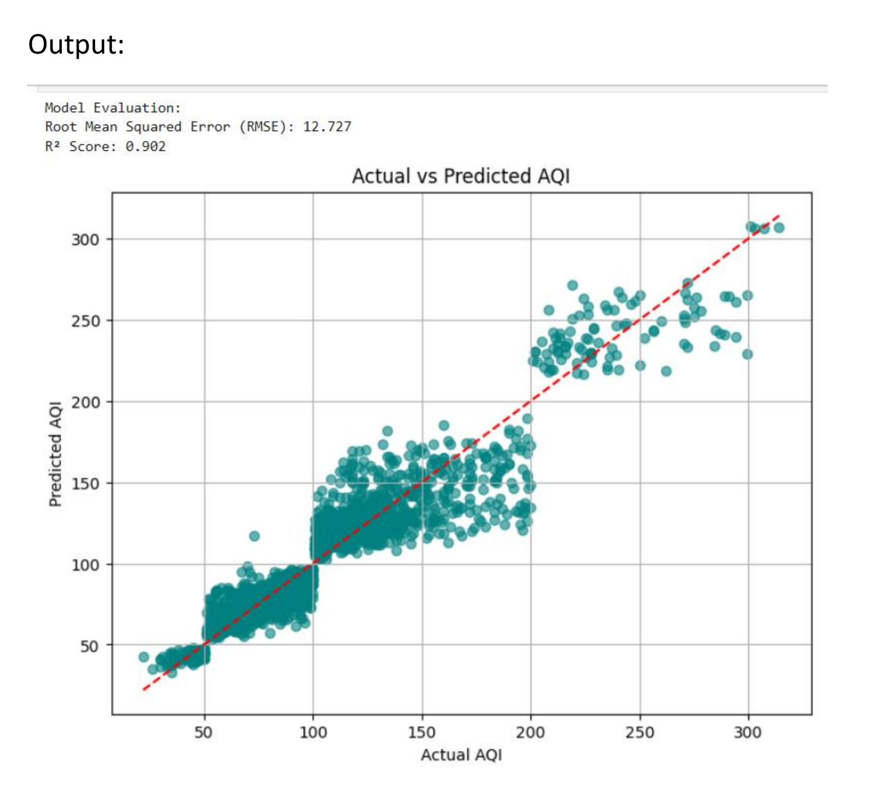
OUTPUT

Slide 12
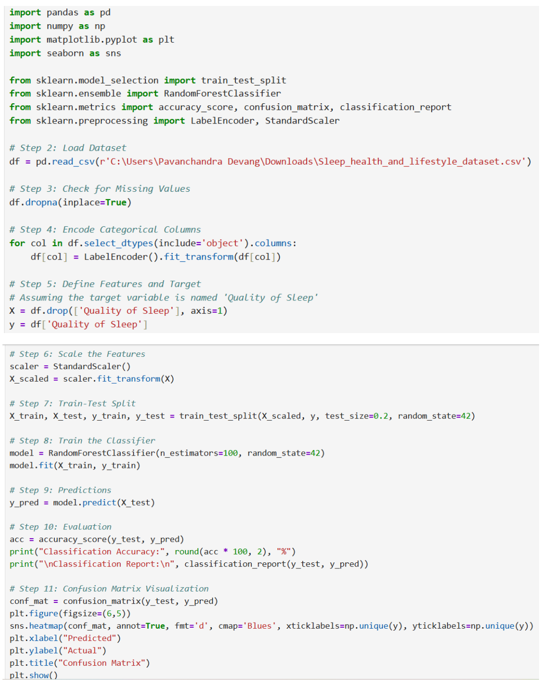
Data Analysis Using Classification Algorithms with Manual Approach
Predict Sleep Quality manually using Python ML libraries.

Slide 13
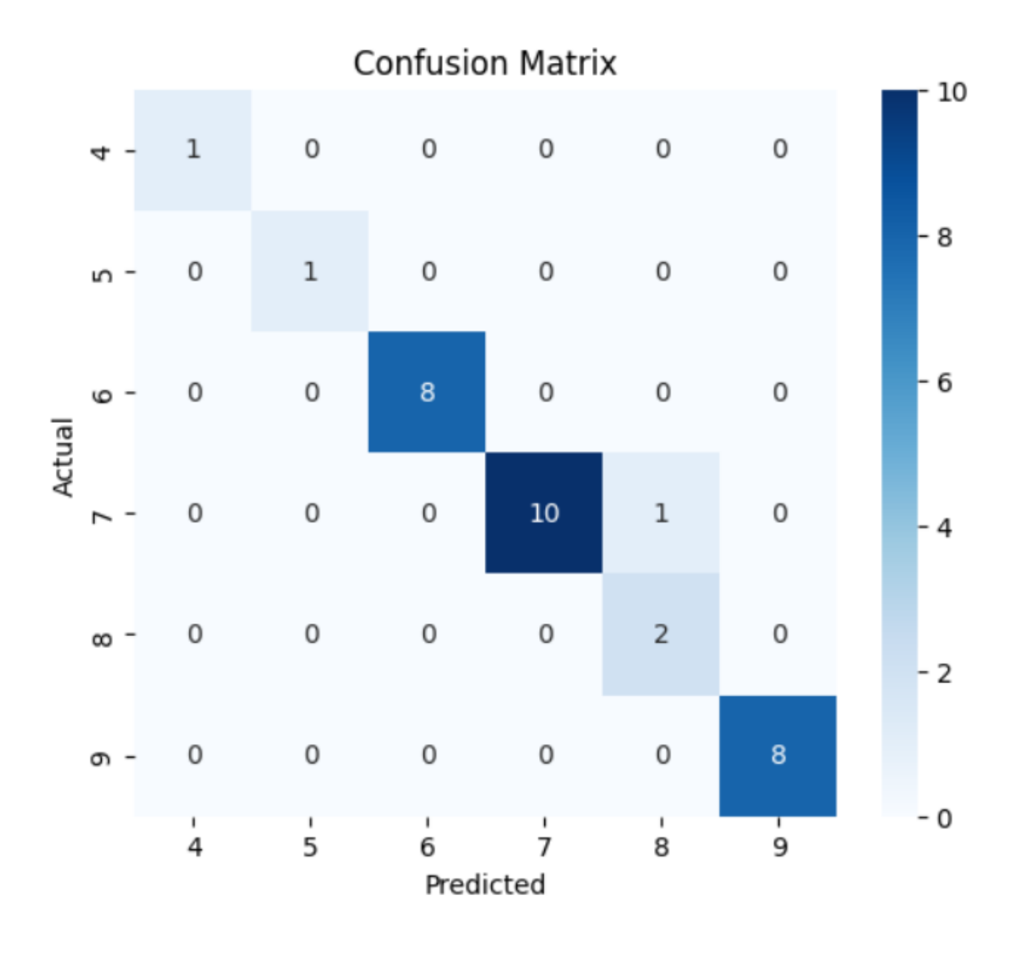
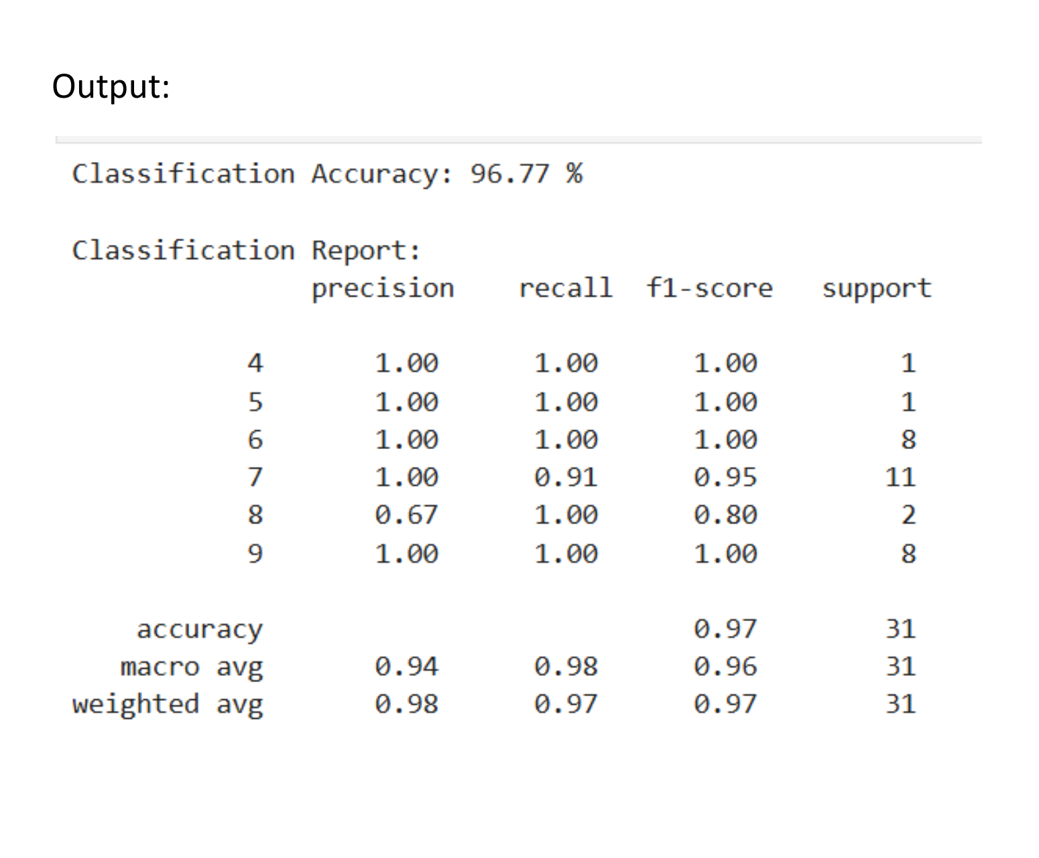
OUTPUT

Slide 14
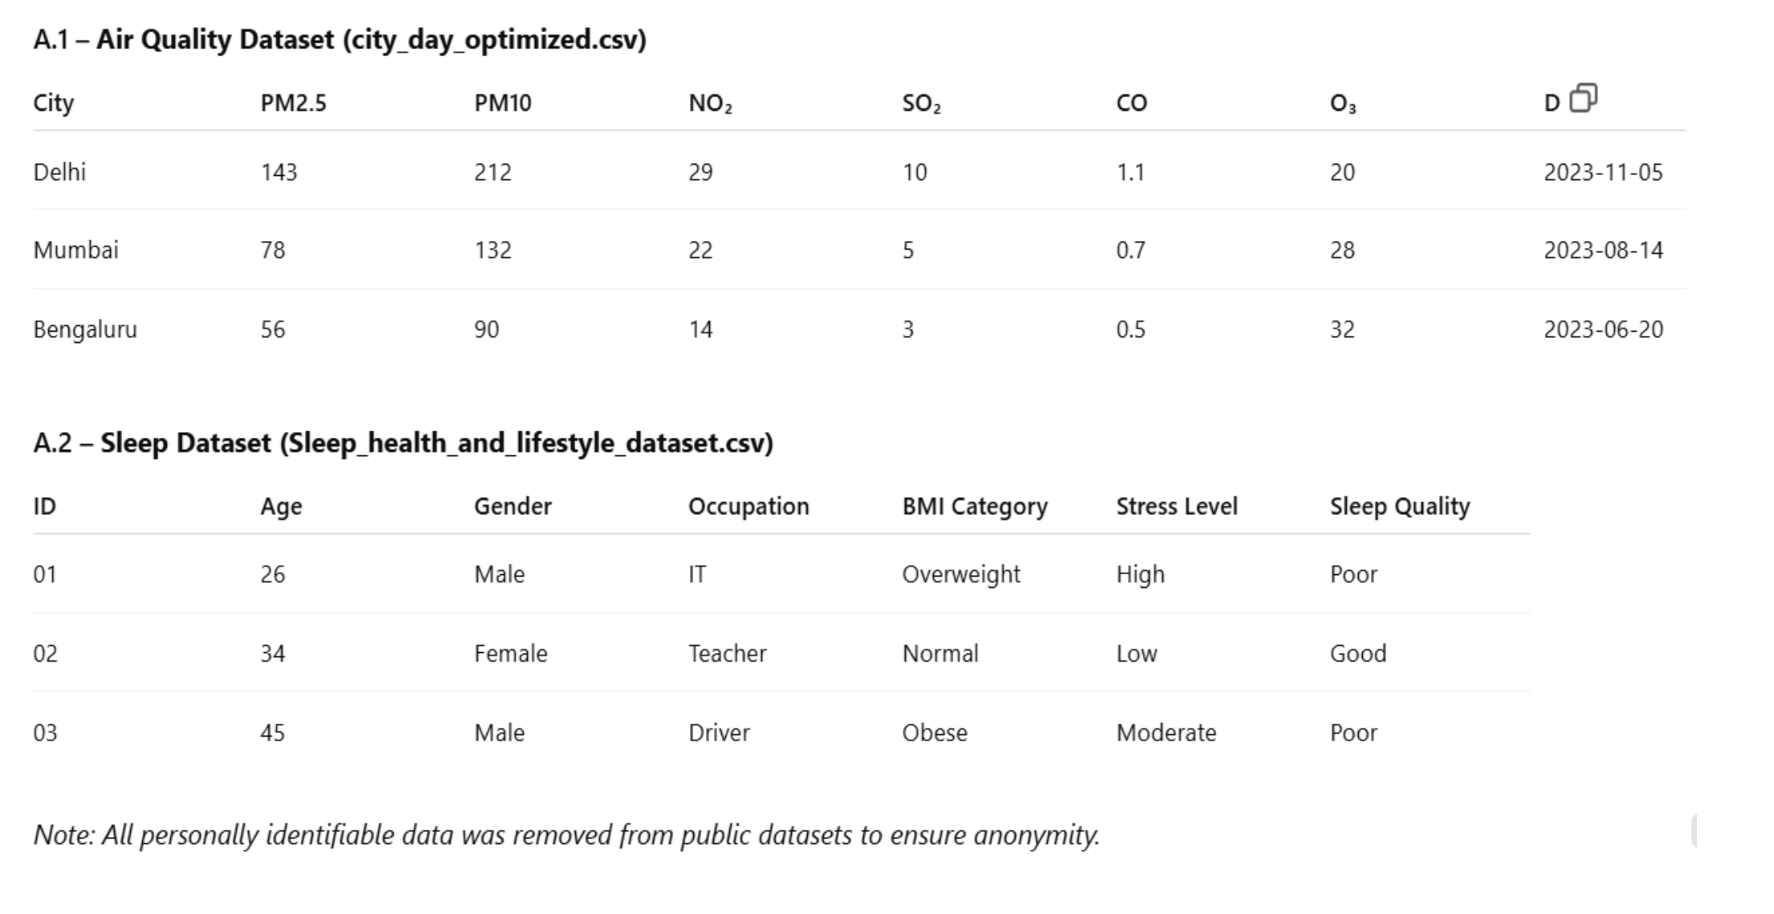
Appendix A: Sample Data Snapshots

Slide 15
Appendix B: Evaluation Metric Summaries
To evaluate model performance, the following metrics were used:
Regression (AQI Prediction)
• RMSE: Measures prediction error; lower is better.
• R² Score: Proportion of variance explained by the model. Closer to 1 is ideal.
Classification (Sleep Quality)
• Accuracy: Percentage of correctly classified entries.
• Precision: True positives / (True positives + False positives).
• Recall: True positives / (True positives + False negatives).
• F1-Score: Balance between precision and recall, especially useful in imbalanced
datasets

Slide 16
Appendix C: AutoAI Visual Output Descriptions
Since screenshots cannot always be embedded in PDFs directly, this section describes the outputs seen from IBM Watsonx AutoAI:
• Feature Importance Chart (Regression): PM2.5 and PM10 were dominant predictors of AQI.
• Residual Plot (Regression): Scatter around zero, indicating good model fit.
• Confusion Matrix (Classification): Strong diagonal values, showing accurate predictions across sleep classes.
• ROC Curve (Classification): AUC ≈ 1.0, indicating excellent separability between Good and Poor sleep.

Slide 17
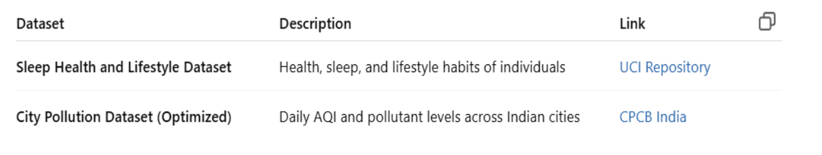
Appendix D: Data Source Documentation

Slide 18
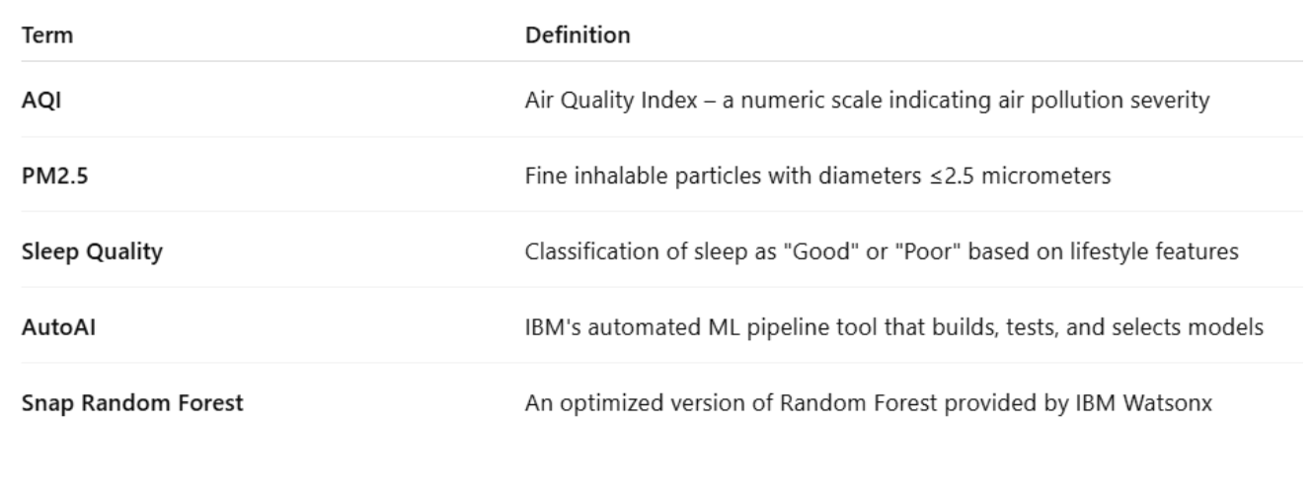
Appendix E: Glossary of Terms

Slide 19
CONCLUSION
This project successfully showcased the potential of IBM Watsonx AutoAI in building and evaluating machine learning models with minimal manual intervention. By focusing on two real-world domains—environmental pollution prediction and health classification—the project highlighted the efficiency and accuracy of AutoAI in solving both regression and classification problems

Slide 20
THANK YOU

